Slide 1
VOICE CONTROLLED ASSISTANT
Presented by: Mark Odhiambo
Supervisor: Mr. Aloo

Slide 2
ORGANISATION.
Background
Problem statement & justification
Objectives
Literature review
Methodology
Budget
Project timeline
End

Slide 3
BACKGROUND.
TASK MANAGEMENT.
VOICE ASSISTANT.
PRODUCTIVITY.

Slide 4
PROBLEM STATEMENT & JUSTIFICATION.
The project will assist to schedule and set tasks through this will increase productivity with the use of a voice controlled assistant. Productivity is important because it will help one accomplish more tasks in less time and more efficiently and avoid inconveniences such as last minute rashes and procrastination.

Slide 5
OBJECTIVES.
Main Objectives.
Specific Objectives.
To design, implement and test a voice assistant, with a real-time update of setting tasks and reminders to boost productivity.
To design and deploy an application display for task scheduling and time management.
To design and test an electronic system for voice detection, synthesize and processing so as to be able to query tasks.
To implement and prototype an electronic system for voice output.

Slide 6


LITERATURE REVIEW.
Audio processing
Processing text.
Text to speech

Slide 7
PROJECT IMPROVISATION.
Activity log(security).
Web interface.
2 point access system.

Slide 8
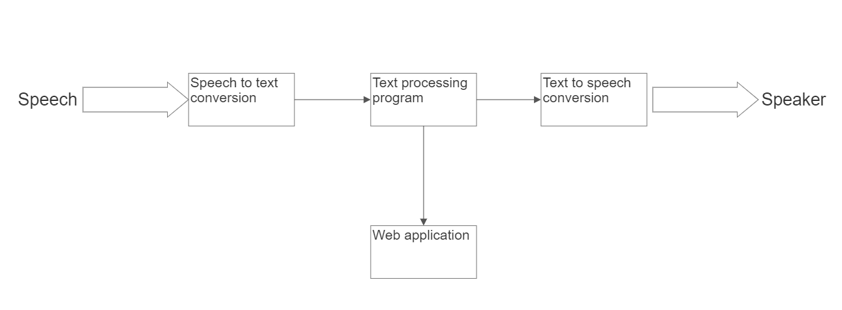
METHODOLOGY

Slide 9
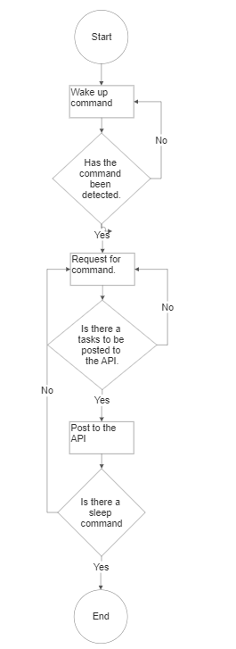
FLOW CHART.

Slide 10
EXPECTED RESULT.
A working prototype of a voice controlled assistant that will be able to display tasks in the application through the use of python api. According to the objectives the voice assistant will be able to post data and get data from the by interfacing with the API and the prototype should be able to have text to speech and speech to text capabilities.

Slide 11
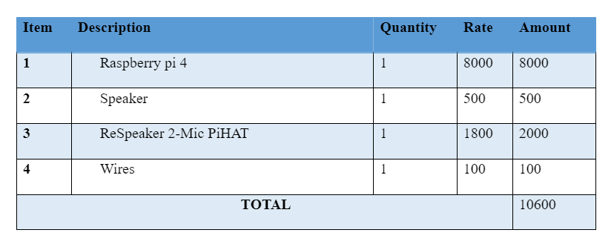
BUDGET.

Slide 12
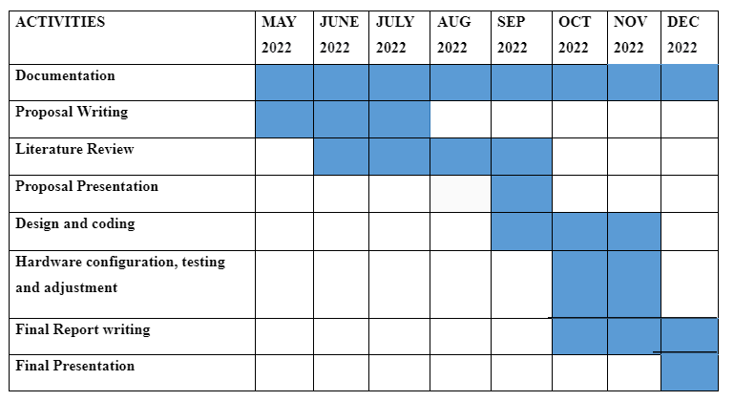
PROJECT TIMELINE.

